Slide 1

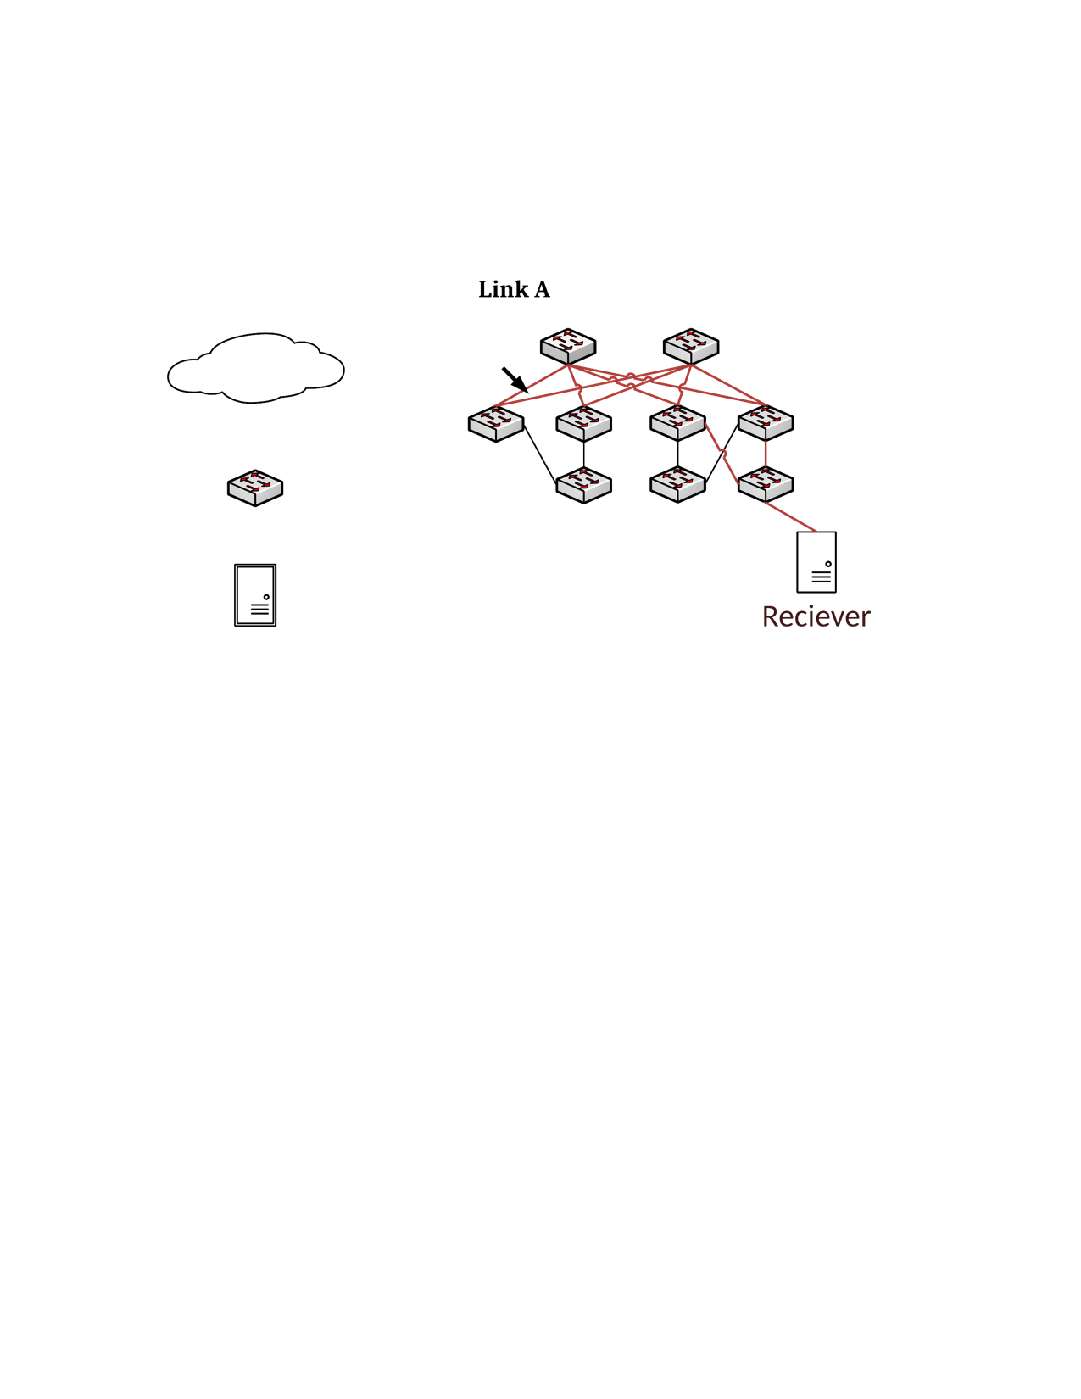
10.10.0.0/24 -> ToR
Default -> Spine
10.10.0.10 -> H1
10.10.0.11 -> H2
Default -> Leaf
H1: 10.10.0.10
H2: 10.10.0.11

Slide 2
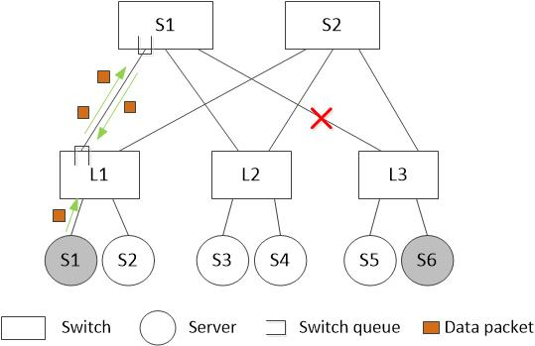
One possible deadlock scenario (1)
1) Link S1-L3 fails when server s1 are sending data to server s6. In this case, the packets are possible to be rerouted back to switch L1 by BGP protocol.

Slide 3
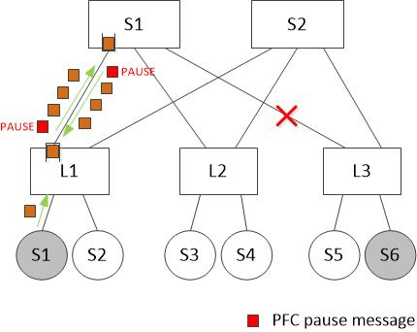
One possible deadlock scenario (2)
2) As more packets are injected into the loop, both queues become full and start to pause each other. This deadlock will not break even after link S1-L3 recovers.

Slide 4
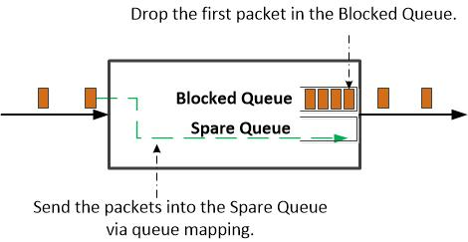
A Preliminary solution for breaking deadlock (1)
Definition of two types of queues:
1) Blocked Queue is a priority queue permanently blocked by deadlock or mad NIC.
2) Spare Queue is another priority queue used for saving the Blocked Queue.

Slide 5
A Preliminary solution for breaking deadlock (2)
Detection of the Blocked Queue: If a queue receives continuous Pause Frames and cannot drain, the switch will mark it as a Blocked Queue.
Local reaction when Blocked Queue is detected: Once a queue is detected as Blocked Queue, the switch will map the new incoming packets to the Spare Queue.

Slide 6
A Preliminary solution for breaking deadlock (3)
Empty the Blocked Queues: Drop the first packet in each Blocked Queue. This drop action can make the Blocked Queues to drain as no Pause Frames will be generated after the current Pause Frame expires.
Recover to normal state: Stop mapping when a Blocked Queue becomes empty.

Slide 7
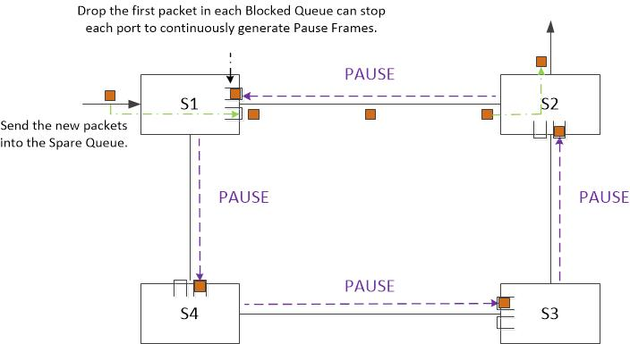
A Preliminary solution for breaking deadlock (4)
An example of 4-hop deadlock.

